Slide 1

SMSTC Opening Symposium
29-30 October 2026
Mondays 11.00-13.00 starting
11 January 2027

Slide 2
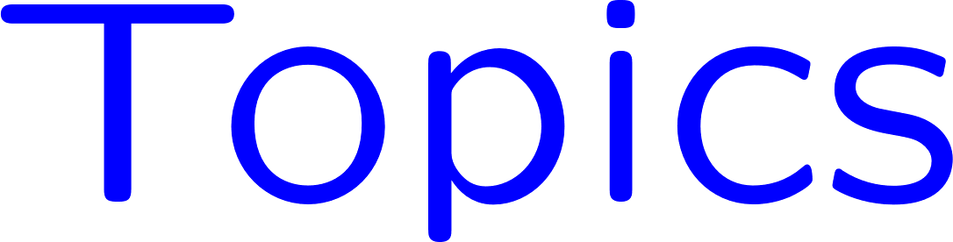

Slide 3
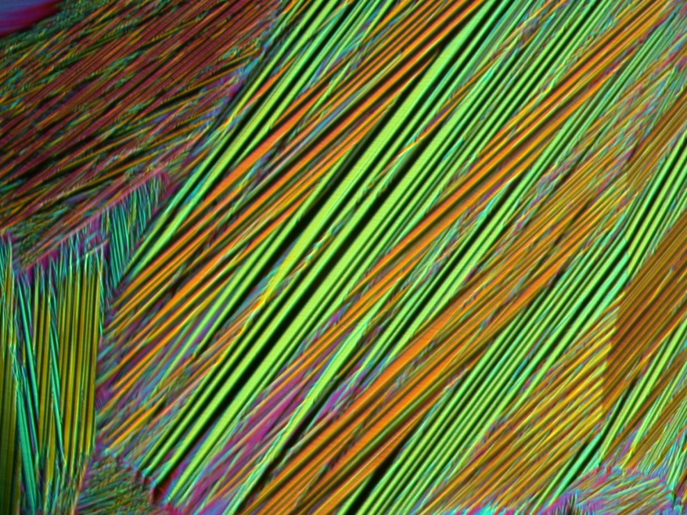
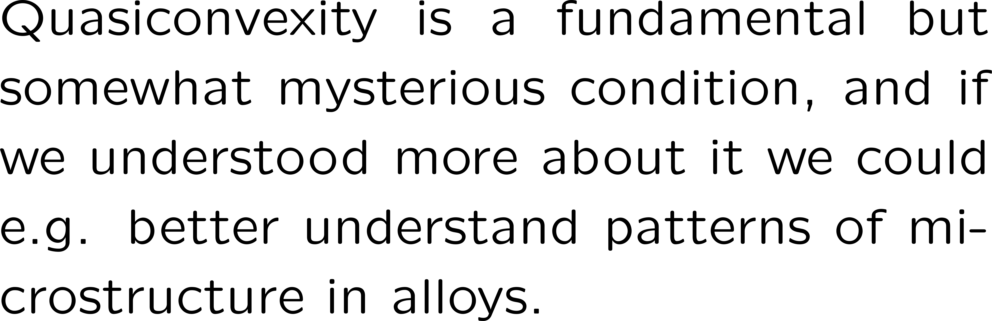

Slide 4
Miscellaneous topics
A selection of topics from current research taking into account the interests of those taking the course. Possibilities include nonlinear elasticity and the microstructure of alloys, liquid crystals, computer vision, Gamma convergence, and connections to dynamics and stability theory.

