Slide 1

Nevil Hopley
Treasurer of RSS Edinburgh Local Group
RSS Graduate Statistician
Data Science Professional
RSS Statistical Ambassador

Slide 2
FREE

Slide 3
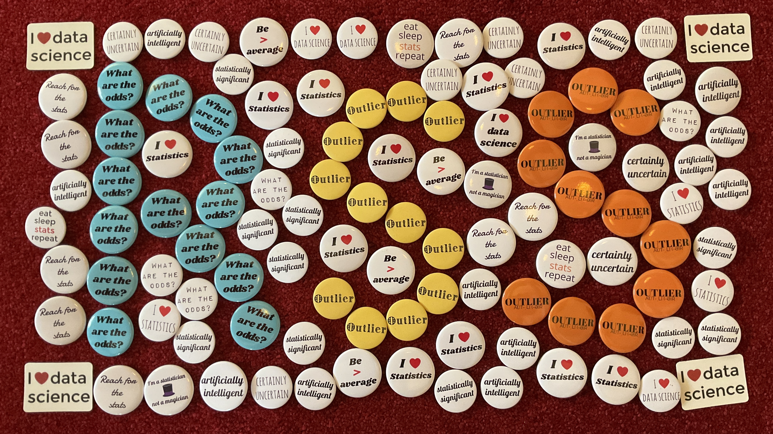

Slide 4
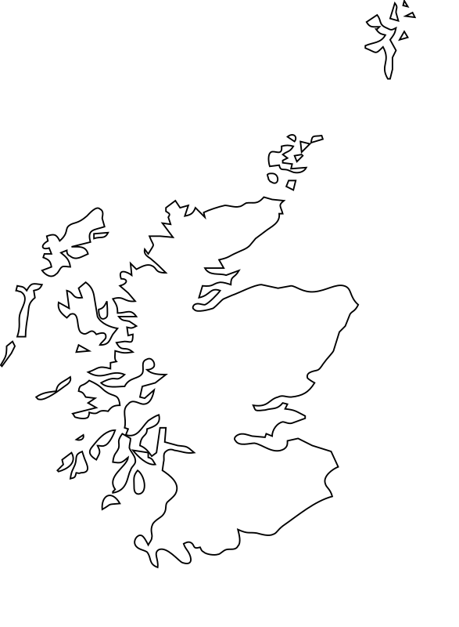

Local Groups in Scotland
No likelihood? No problem! — Bayesian Statistics in R
Specialist statistics education at 16-18: State of play in Scotland, England and Wales
Ethical Data Use in Practice
How Inclusive Statistics Still Box Us In
Exploring the statistics behind the Edinburgh Fringe
When does AI go wrong?
Forensic Figures: DNA, Fingerprints & Stats
Queer Data: Who Counts?
Mapping visual metaphors to civic facts
Jobs of the Unknown: a Maths Week Scotland Careers Event
Astro Informatics, the Data Science of Astronomy
Chain event graphs for reasoning in legal trials.
Real World Statistics: a Discussion Panel
See the Data, Be the Data
Ethical funding in Artifical Intelligence
Undergraduate Student Final Year Project Presentations
No likelihood? No problem! — Bayesian Statistics in R
Notes:
Scotland Map: https://www.cleanpng.com/png-scotland-blank-map-clip-art-map-of-scotland-5770301/download-png.html
Map Pin: https://www.flaticon.com/free-icon/location_5690026

Slide 5
£0.00

Slide 6

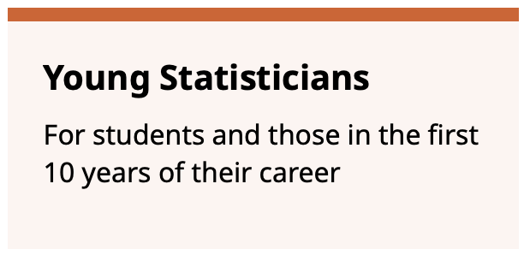
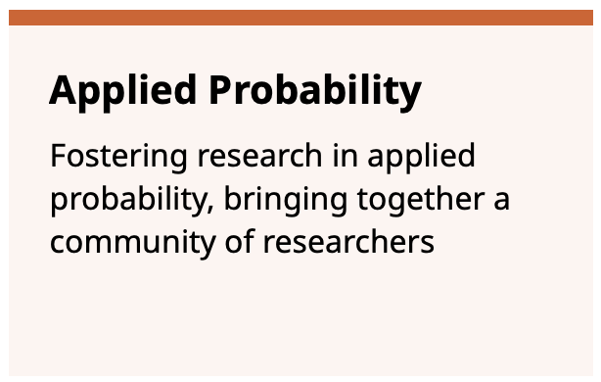
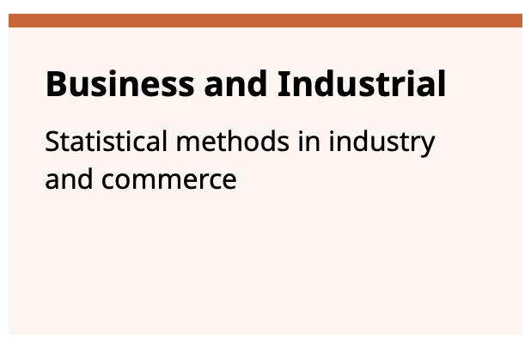
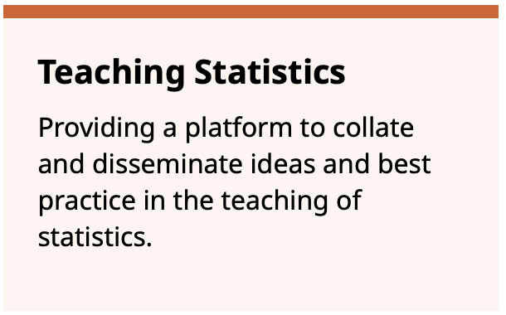
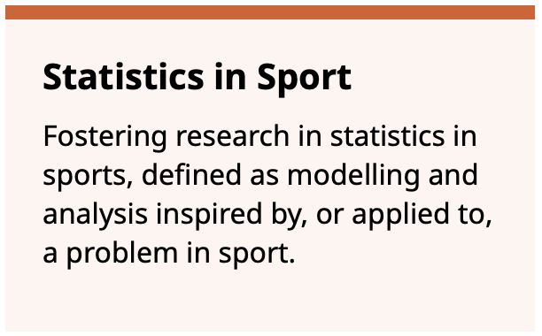
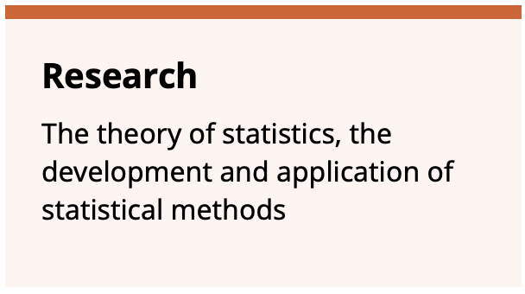

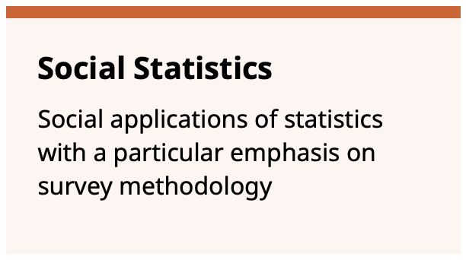
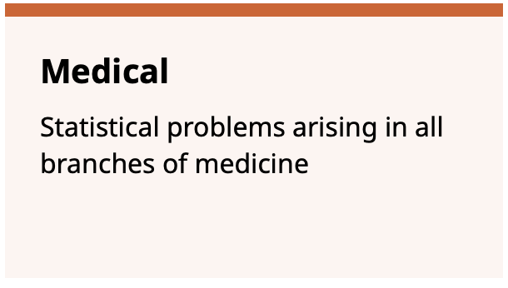
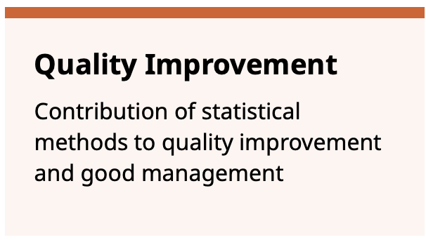
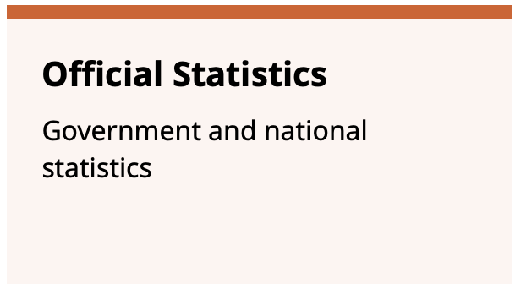
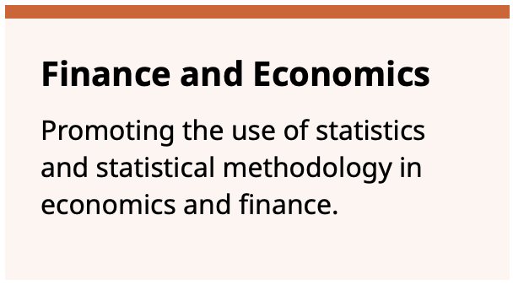

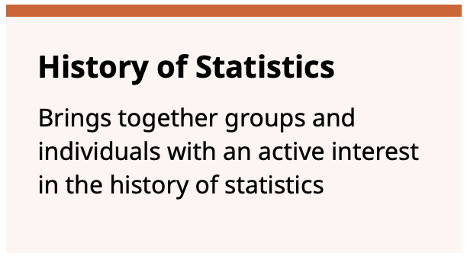

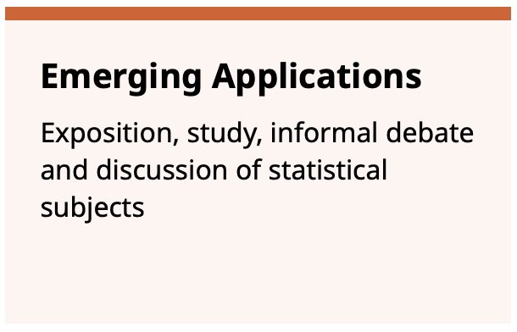

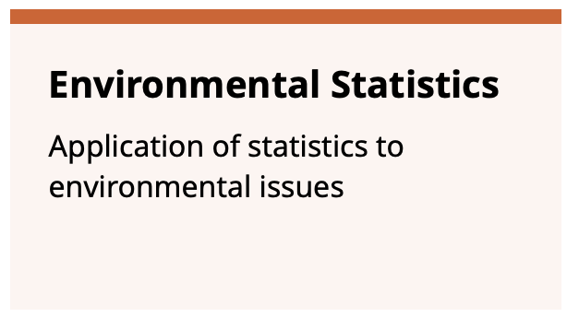
rss.org.uk

Slide 7
Professional Memberships
Chartered Statistician
Advanced Data Science Professional
Graduate Statistician
Data Science Professional
Data Analyst
Fellow
Notes:
https://www.freepik.com/free-vector/realistic-vector-icon-illustration-wooden-ladder-isolated-white-background_29287165.htm#query=ladder%20on%20background&position=0&from_view=keyword&track=ais_hybrid&uuid=5e0a30ad-cfc0-457b-81f8-dfc0a7661f40

Slide 8

PhD prize in
Applied Probability
PhD prize in
Emerging Applications
potential for long term impact on applied probability
and/or
its potential to reach out into statistical science and other application areas, both established and novel.
contribution to an emerging application of statistics and its potential for long term impact on the field of statistics.
Notes:
Logo from https://dashboard.clubzap.com/public/articles/40954

Slide 9
Come and Chat
....and pick a free badge!

