Slide 1
Getting involved with RSS
Fraser Daly (F.Daly@hw.ac.uk)
Vice Chair, Applied Probability Section

Slide 2
The Royal Statistical Society
Professional body for statisticians and data analysts
Advocates for the importance of statistics and data
Ensure that policy and decision making are informed by evidence
Local Groups and Sections organise events (often free to attend)

Slide 3
Getting involved
The easiest way to get involved is to become a member
A few options:
e-student membership – free, access to significance magazine and fortnightly newsletter
Fellowship - £71 per year (£66 if you sign up direct debit)
Membership type | Cost | Benefits
e-Student membership | Free for PhD (and other) students | Fortnightly newsletter, access to RSS Significance magazine
Fellowship | £72.50 per year concessionary rate, £145 full rate (£5 off if direct debit) | Professional accreditation Access to RSS journals Take part in volunteering initiatives Member discounts with publishers
GradStat (requires UK honours at 2:2 or equivalent) | £77.50 per year concessionary rate, £155 full rate (£5 off if direct debit) | Fellowship benefits plus: GradStat letters after your name Access to Gradstat mentoring Networking opportunities

Slide 4
RSS in Scotland
There are three Scottish RSS Local Groups:
Glasgow – covers Glasgow and the West
Edinburgh – covers Edinburgh/Fife
Highlands – based in Aberdeen, covers the north of Scotland
As a fellow you can get involved in the group committees

Slide 5
RSS Sections
Sections cover a variety of specific areas
Young Statisticians Section specifically aimed at individuals starting out a statistical career
Applied Probability
Business & Industrial
Computational Statistics & ML
Data Ethics & Governance
Environmental
Emerging Applications
Environmental Statistics
Finance & Economics
History of Statistics
International Development
Medical
Official Statistics
Quality Improvement
Research
Social Statistics
Statistics & the Law
Statistics in Sport
Teaching Statistics

Slide 6
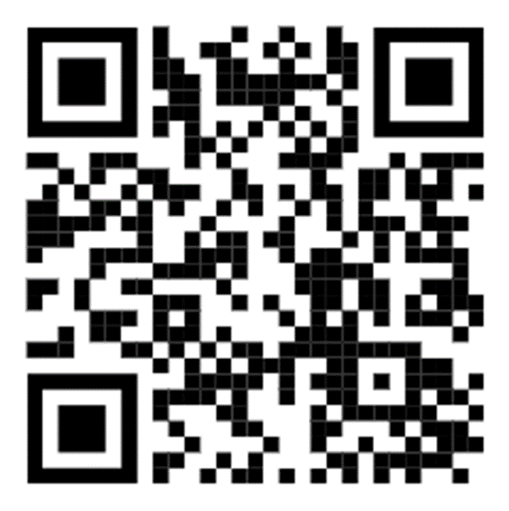
More Information
For more information visit
rss.org.uk
Sign up to Section & Local Group newsletters
Details of upcoming events
Membership information

